Slide 1

Basic Details of the Team and Problem Statement
Ministry/Organization Name/Student Innovation: Government of Jammu and Kashmir
PS Code: SIH1352
Problem Statement Title:
Traditional agriculture practices lack real-time monitoring and efficient operation on fields This leads to inefficiencies and low production levels.
Team Name: Agribytes Team Leader Name: Nishkarsh Jain
Institute Code (AISHE): U-0385
Institute Name:
Thapar Institute of Engineering and Technology
Theme Name: Agriculture, FoodTech & Rural Development

Slide 2
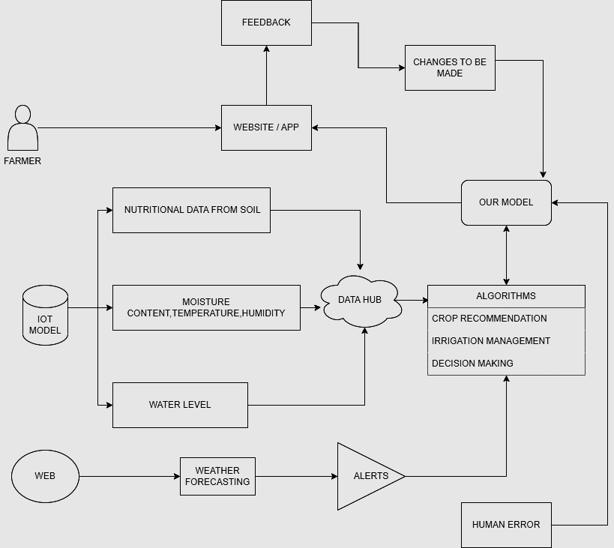


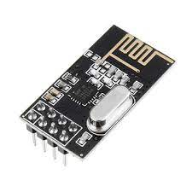
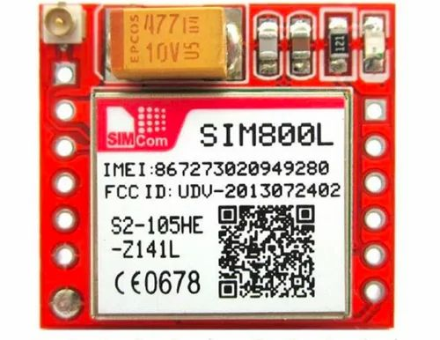
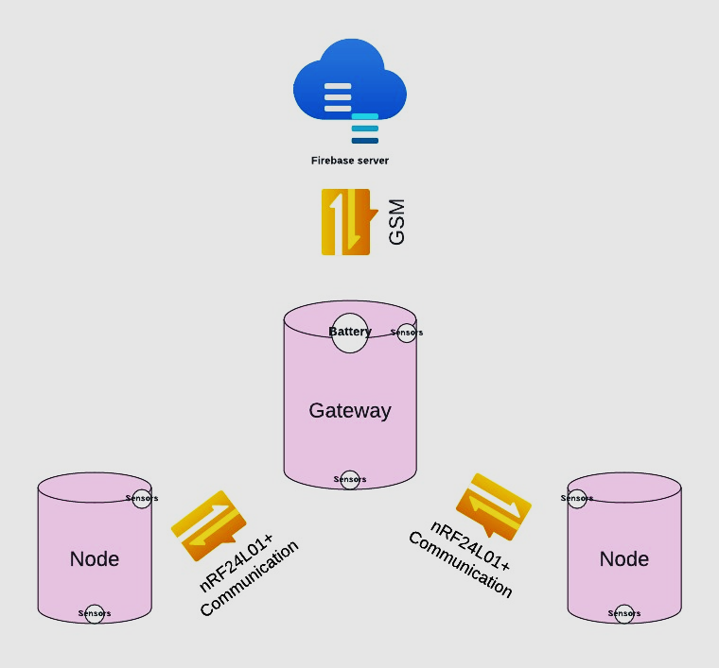
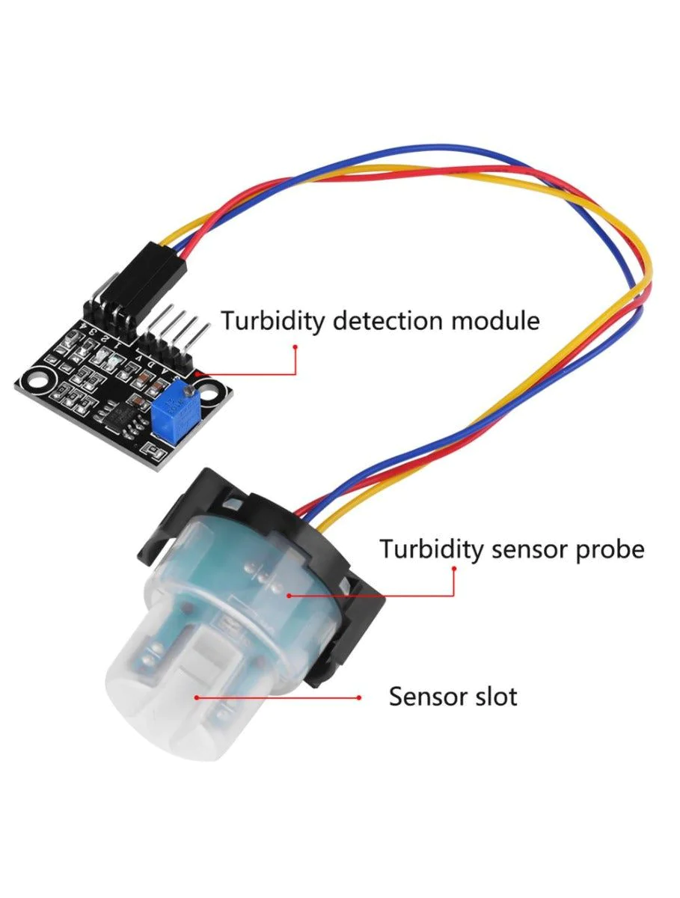
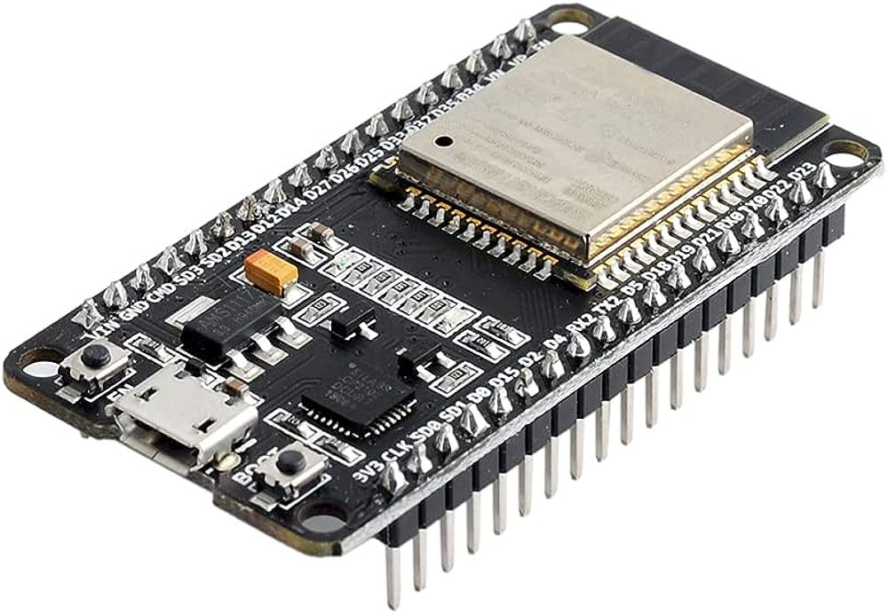



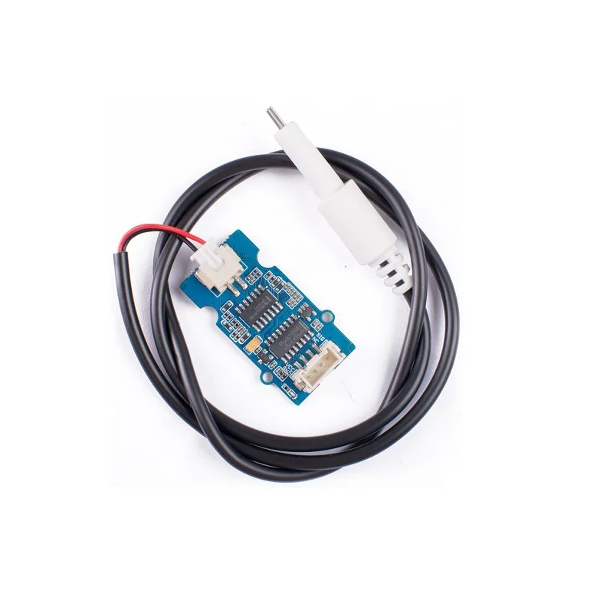







Idea/Approach Details
Idea:
All-in-one digital companion for Paddy farmers
Disease(i.e. Blast, Sheath Blight) detection
Measures standing water levels, conserve water
Soil Nutrient & Moisture measurement
Water Turbidity and TDS measurement
Timely Weather alerts & Government Warnings
local Ag-Tech directory & useful Ag-Calculators
Daily crop prices and market status
Data-driven insights & Government Policy alerts
Direct connections between local end-consumer and farm
Measures standing water levels, conserve water
Technology stack:
GSM 800LA
NRF 24L01
ESP32
2

Slide 3
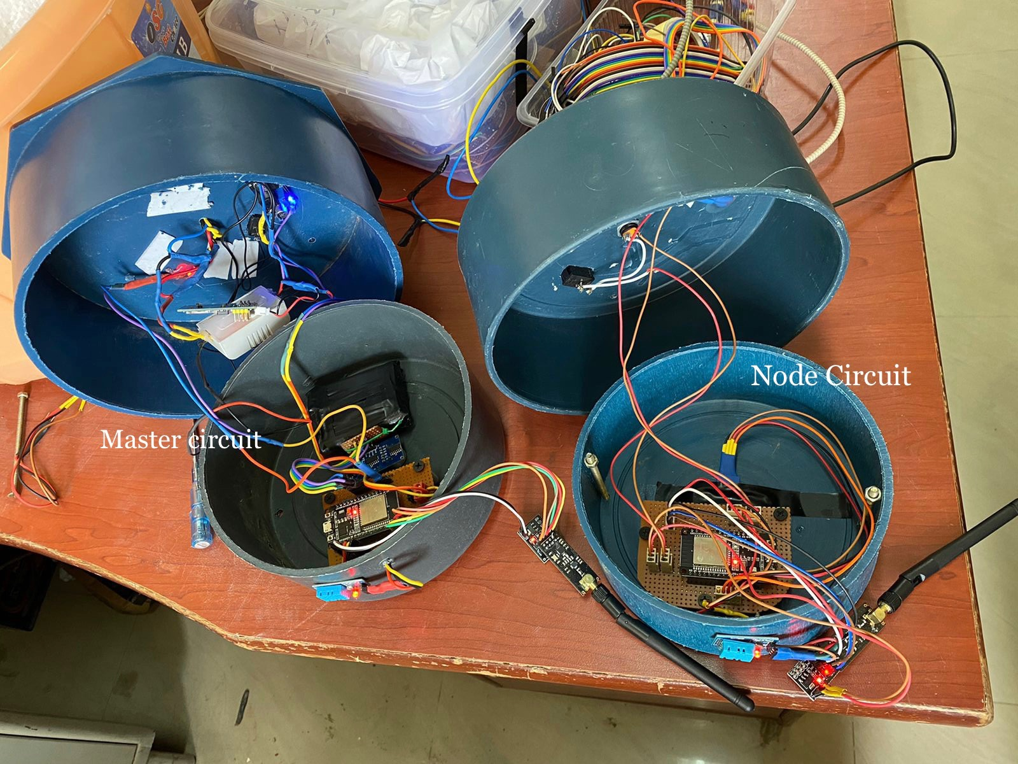
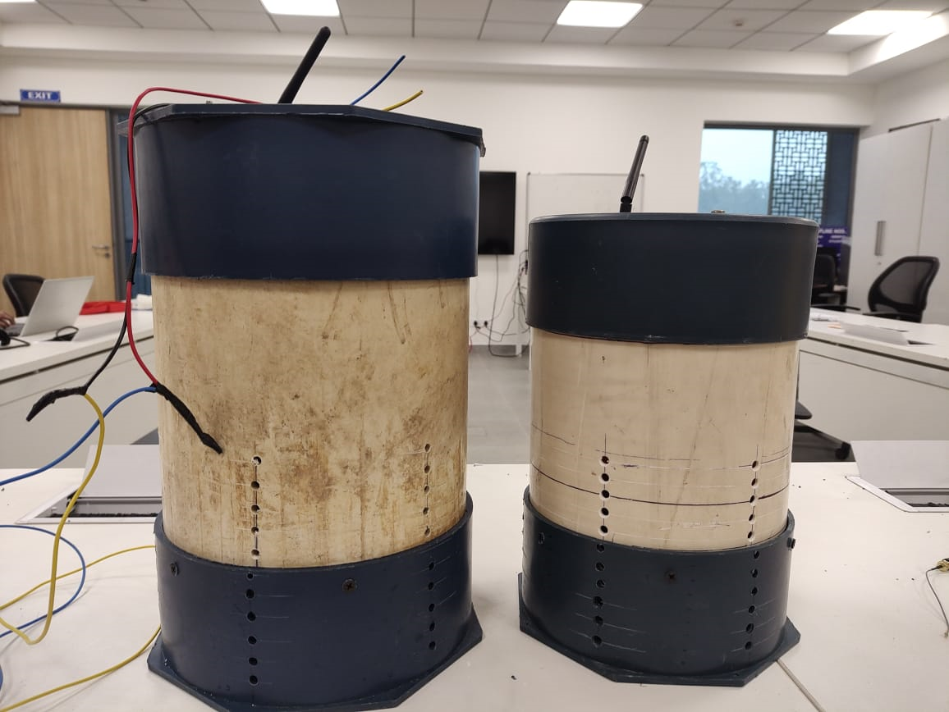
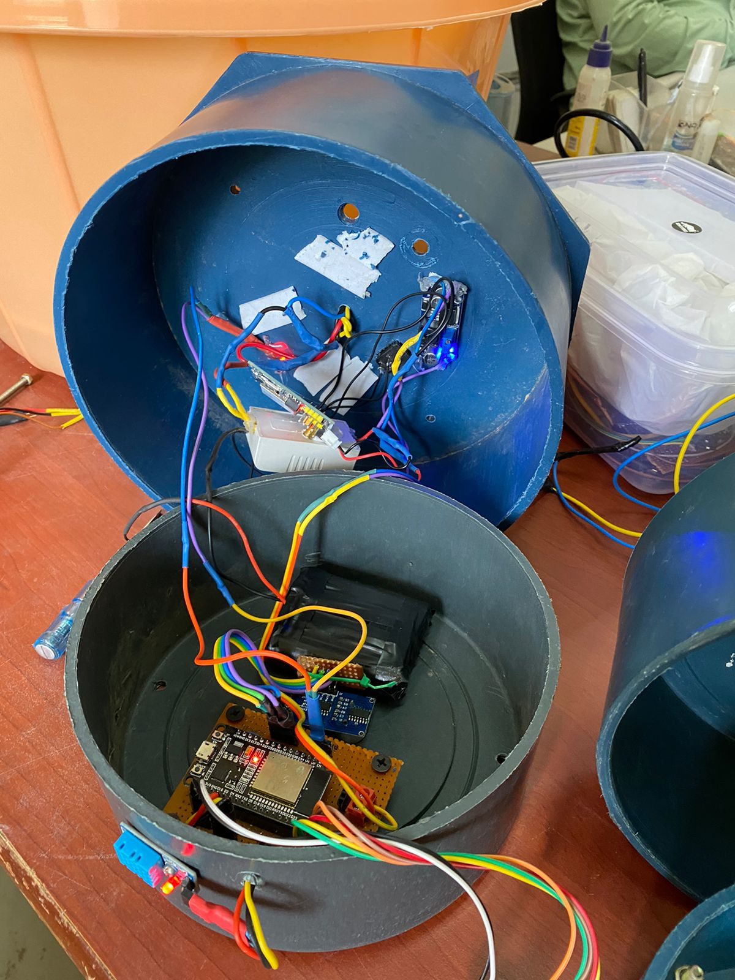
Idea/Approach Details
Use Cases here
Show-stoppers
Crop Health Monitoring
Precision Water Management
Nutrient Optimization
Fair Pricing and Direct Sales
Data-Driven Decision-Making
Real time notifications
Pest and weed control
Health Guardian
Wise Water Management
Nutrient Precision
Fair Market Price Information
Data-Driven Excellence
Multilingual interface
Easy installation and maintenance
Dependencies
Farmers must be ready to adapt to new technology.
Irrigation system on farms must be compatible with existing technology with minor modification
Network connectivity in the area

Slide 4
Team Member Details
Team Leader Name: Nishkarsh Jain
Branch : BE Stream: ECE Year : III
Team Member 1 Name: Shreya N. Bhojake
Branch: BE Stream: ECE Year: III
Team Member 2 Name: Madhav Anand
Branch: BE Stream: ECE Year: III
Team Member 3 Name: Naman Chaudhary
Branch: BE Stream: ECE Year: III
Team Member 4 Name: Romit Soni
Branch: BE Stream: ECE Year: III
Team Member 5 Name: Ansh Srivastava
Branch: BE Stream: ECE Year: III
Team Mentor 1 Name: Dr. Karmjit Singh Sandha Expertise: IOT & Embedded Systems Domain Experience (in years): 6+

